Slide 1
Digital Image Processing - Elementary Methods
By Tinsae Shemalise

Slide 2
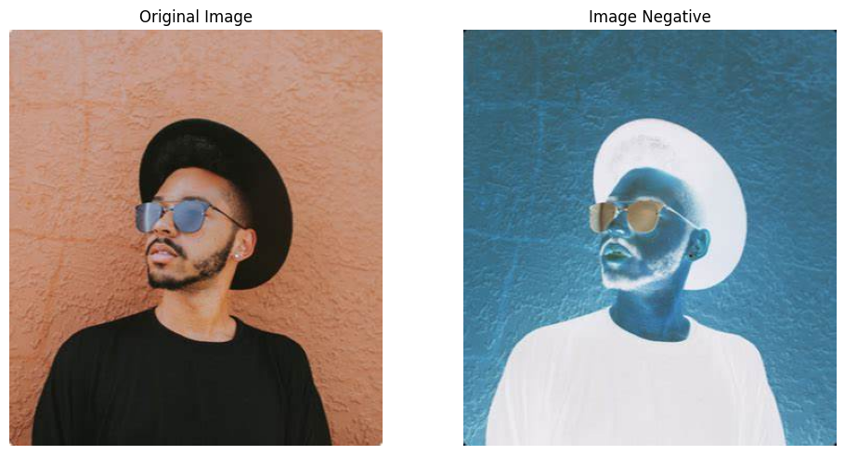
Image Negative
Produces the negative of an image by inverting its pixel values. Bright areas become dark and vice versa, enhancing contrast in certain image types like X-rays or satellite photos.

Slide 3
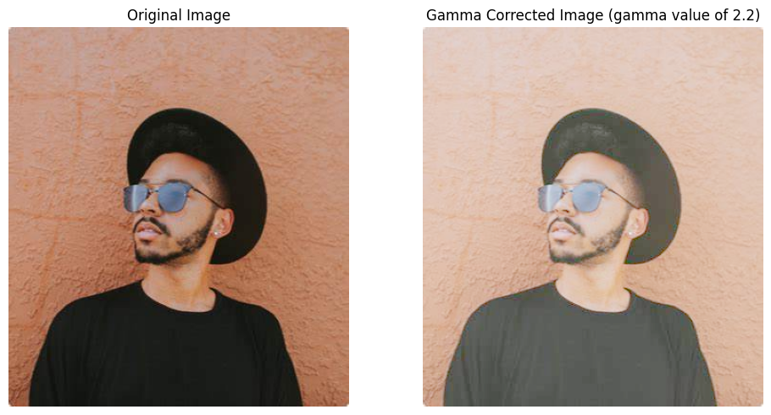
Gamma Correction
Adjusts the brightness of an image non-linearly using a gamma value. It’s useful for correcting lighting issues and enhancing details in under- or over-exposed regions.

Slide 4
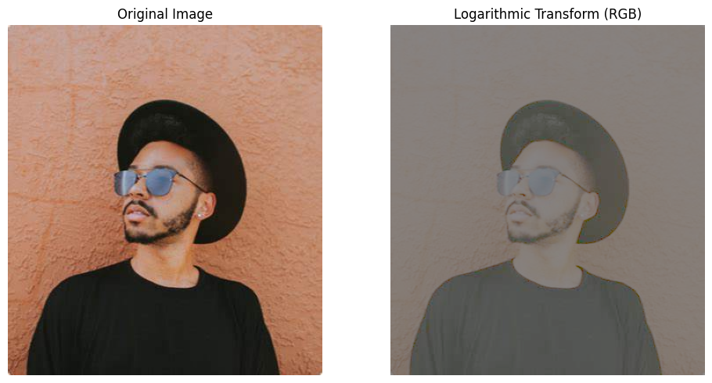
Logarithmic Transform
Enhances low-intensity pixel values by applying a logarithmic function. It is particularly effective for revealing details in dark regions of an image.

Slide 5
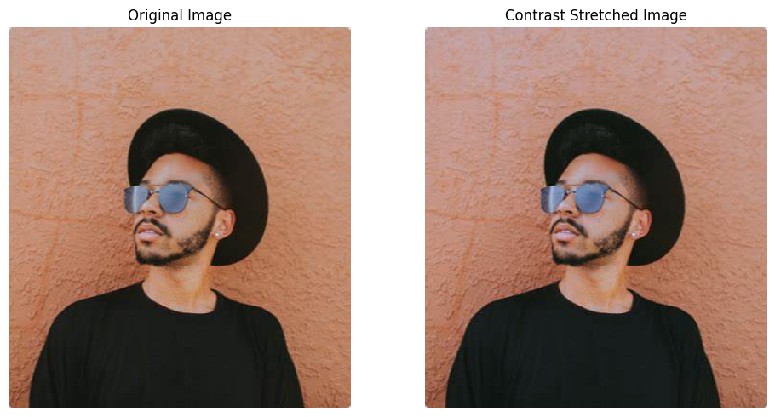
Contrast Stretching
Expands the range of intensity values to improve image contrast. It’s a linear normalization technique that enhances visibility of features in low-contrast images.

Slide 6
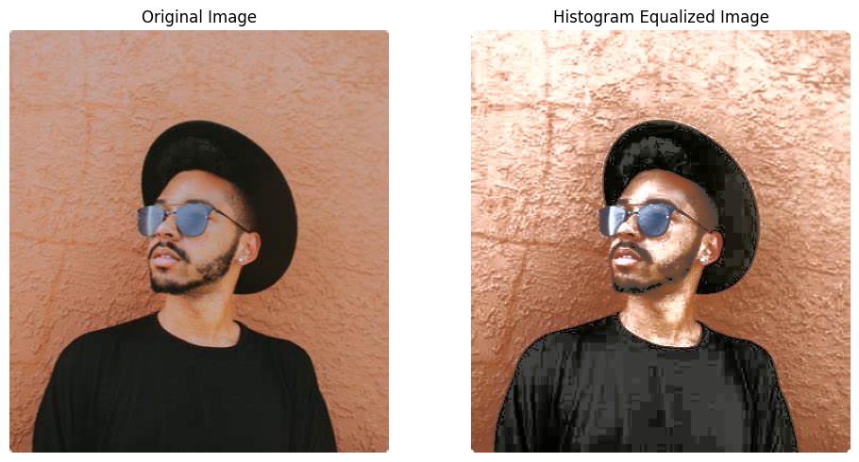
Histogram Equalization
Redistributes the intensity values to flatten and stretch the dynamic range of the histogram. It enhances contrast, especially in images with poor lighting.

Slide 7
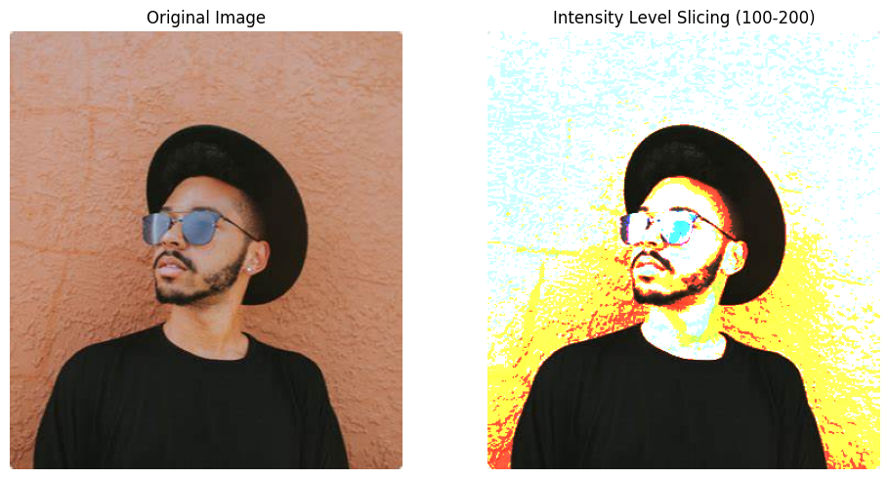
Intensity Level Slicing
Highlights specific ranges of intensity values while preserving or suppressing the background. Useful in medical imaging or feature extraction where certain intensity bands are important.

Slide 8
Bit Plane Slicing
Decomposes an image into its binary bit layers, revealing details hidden in individual bits. Useful for analyzing fine textures or compressing and encrypting images. In the next slide I will show the results for bit plane slicing over 8 bit planes, i.e 0 through 7.

Slide 9
